Slide 1
Analyzing New York’s Parking Tickets
By: Javier Nava, Oscar Munoz,
Jesse Fabian, Ky Hoang

Slide 2

Project Overview
We will be analyzing New York City’s Parking Tickets.
https://www.kaggle.com/new-york-city/nyc-parking-tickets#Parking_Violations_Issued_-_Fiscal_Year_2017.csv

Slide 3
Project Objectives
Our project objectives is to answer the following questions:
What are the top 5 car models that get the highest amounts of parking tickets?
What were the states that had higher number of cars with violations in New York?

Slide 4
Project Objectives (Continued)
What are the top 5 colors of cars that have the most amount of parking tickets?
Where there any license plates that had more than 80 violations?

Slide 5

Deliverable
We will be delivering our insights using:
Amazon Web Services to Pull our data.
Apache Pig to filter the data.
Microsoft Power Bi to visualize & our findings.

Slide 6



Software Being Used
We will be using Amazon Web Services to host our data.
We will use Hadoop and Pig to store and clean our data.
Finally, we will use Microsoft Power Bi to Visualize our data.

Slide 7

H/W experimental Specifications
Cluster Version: 2.7.1
Cluster Number of Nodes: 5
Memory Size: 150 GB
CPU Speed: 2195 MHz

Slide 8
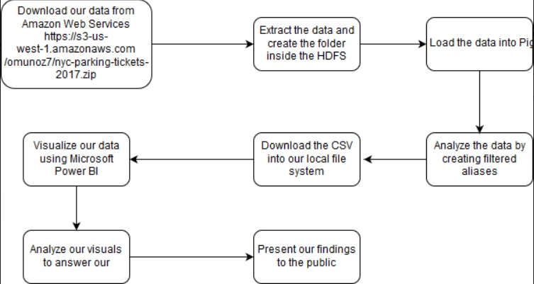
Flow Chart

Slide 9
Hosting our data
We are using Amazon Web Services to host our data.
We have provided the link below: https://s3-us-west-1.amazonaws.com/omunoz7/nyc-parking-tickets-2017.zip
Our data size is 2.0 GB

Slide 10
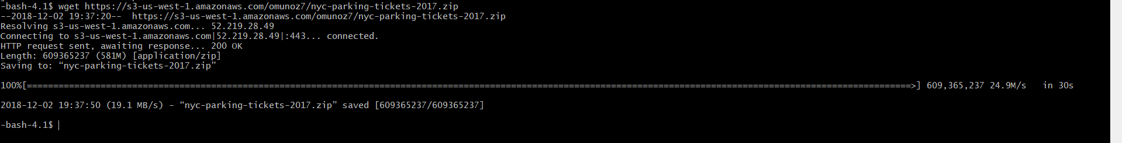
Downloading and Unzipping our data from AWS
The First thing we do is download the data set from Amazon Web Services
Next, we unzip the file

Slide 11

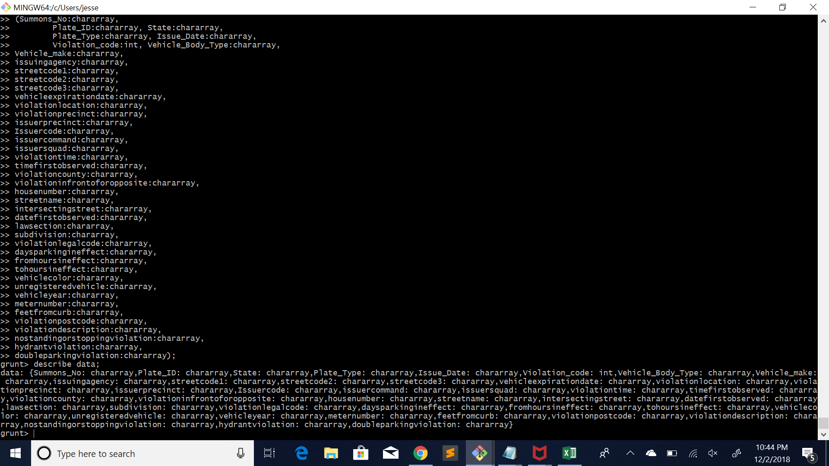
Put/Upload the data files into user’s directory.
Enter Pig and load the data file.
Describe “Data”

Slide 12
Loading data into pig and defining the columns

Slide 13
Describe “data” to make sure it was successful

Slide 14
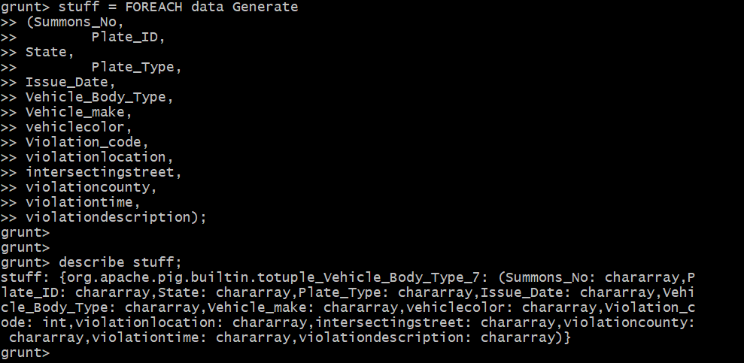
Filter data for only needed fields and describe the filtered data for confirmation.

Slide 15
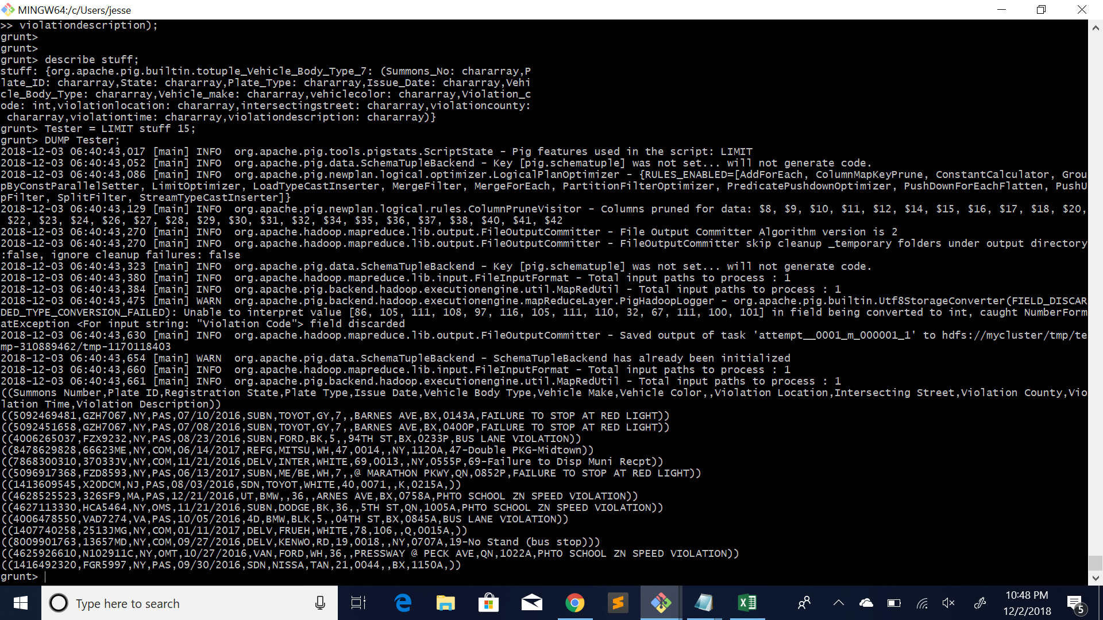
Test filtered data by using a DUMP command with limit of 15 records.

Slide 16
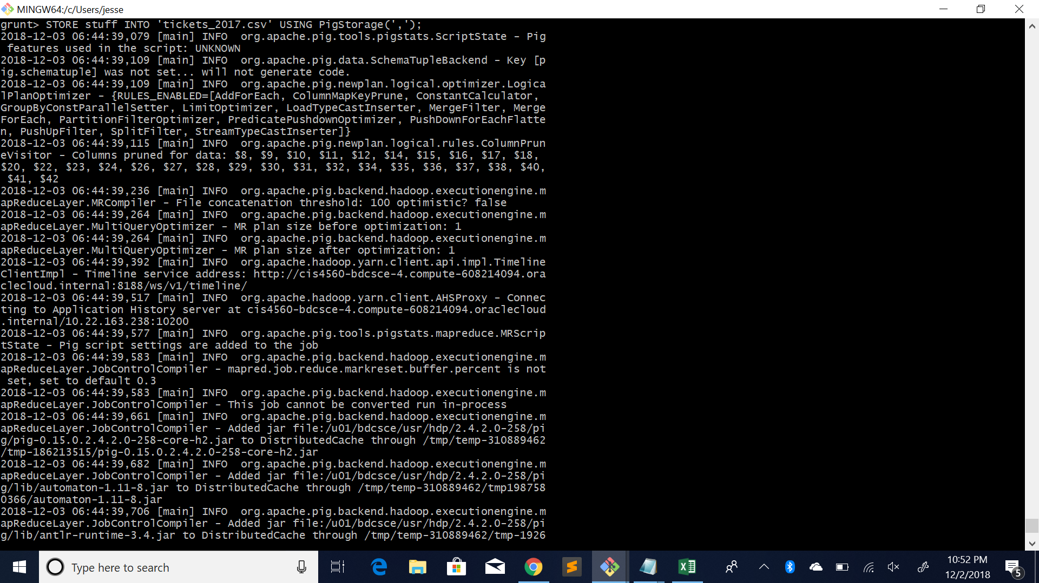
Store into Hadoop File System

Slide 17
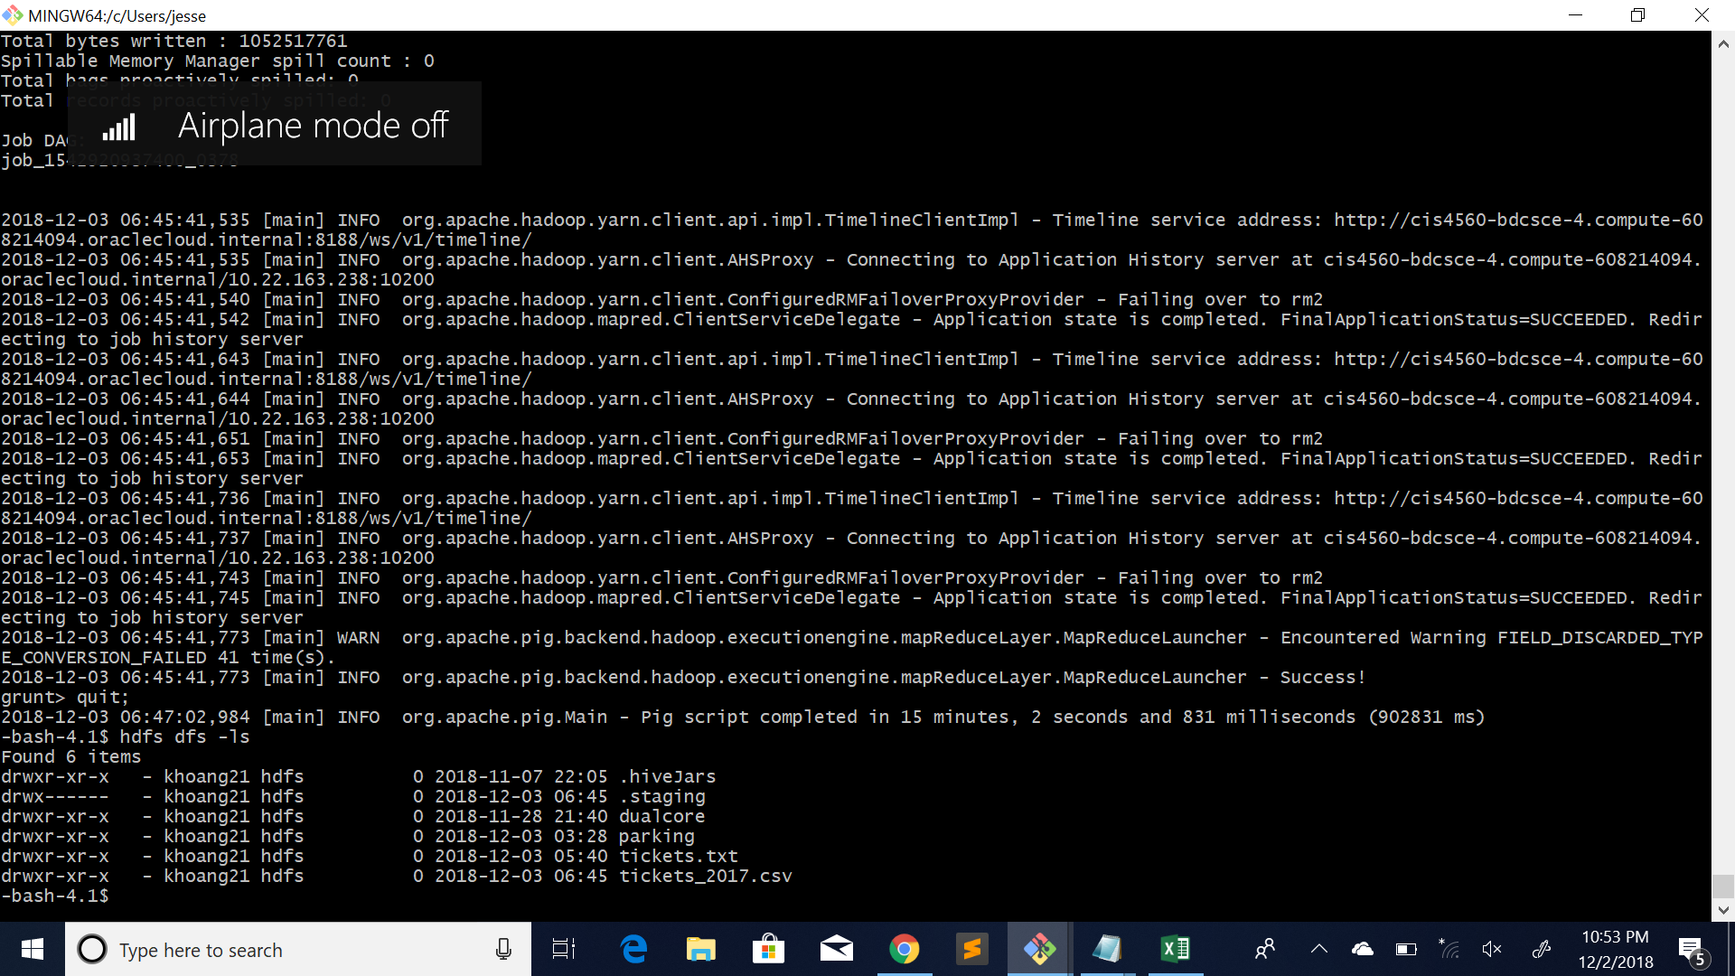
Checking if its present in hadoop file system

Slide 18
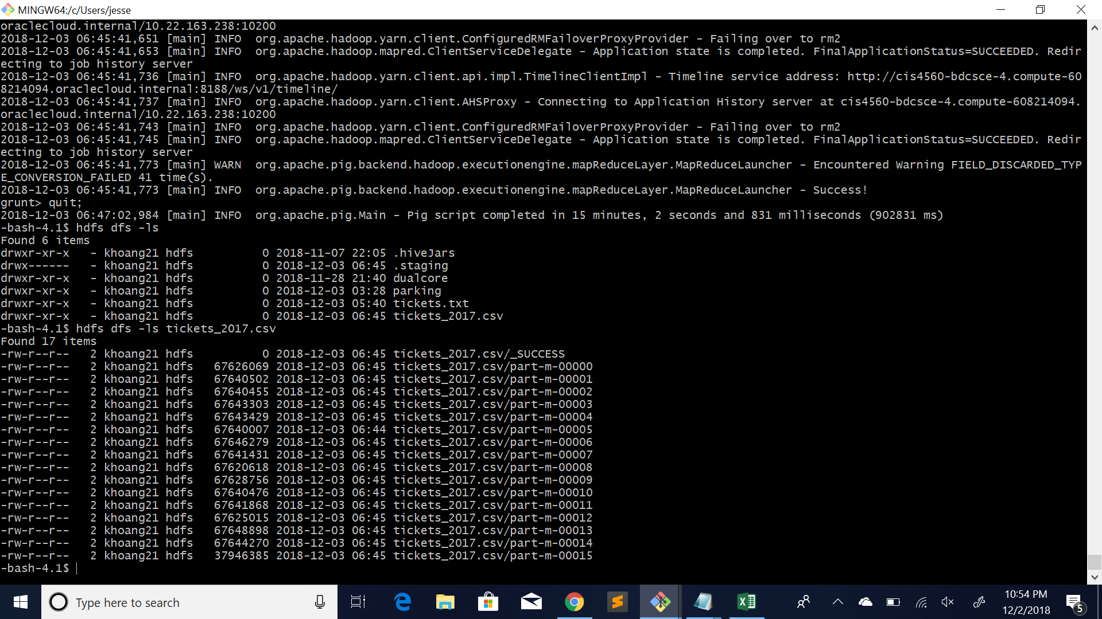
Checking if data is present in my file

Slide 19
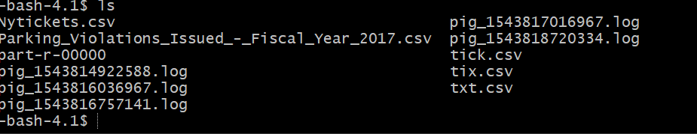
Converting Pig results into a csv file!
Checking if csv file exist

Slide 20

Downloading the csv file to local system

Slide 21
Data Visualization

Slide 22
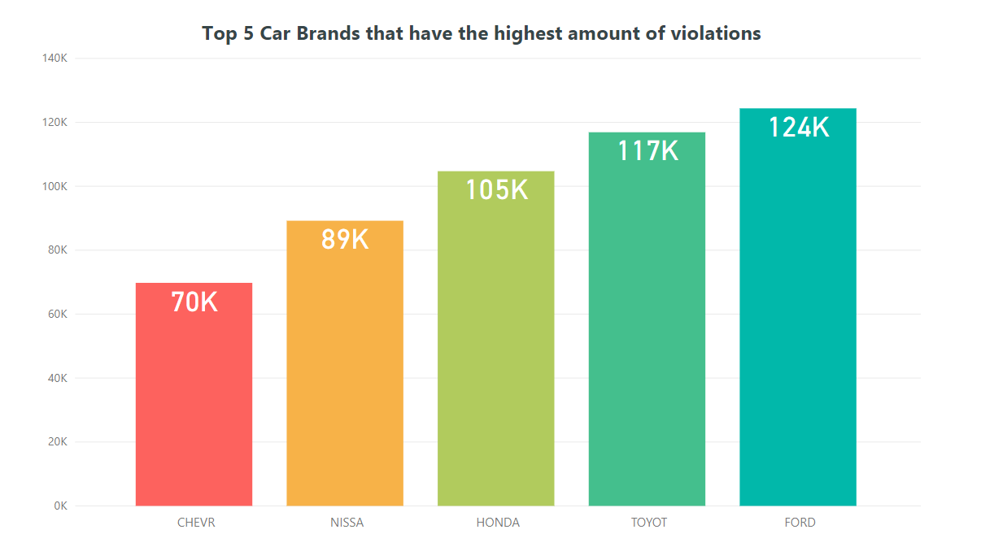
What are the top 5 car models that get the highest amounts of parking tickets?

Slide 23
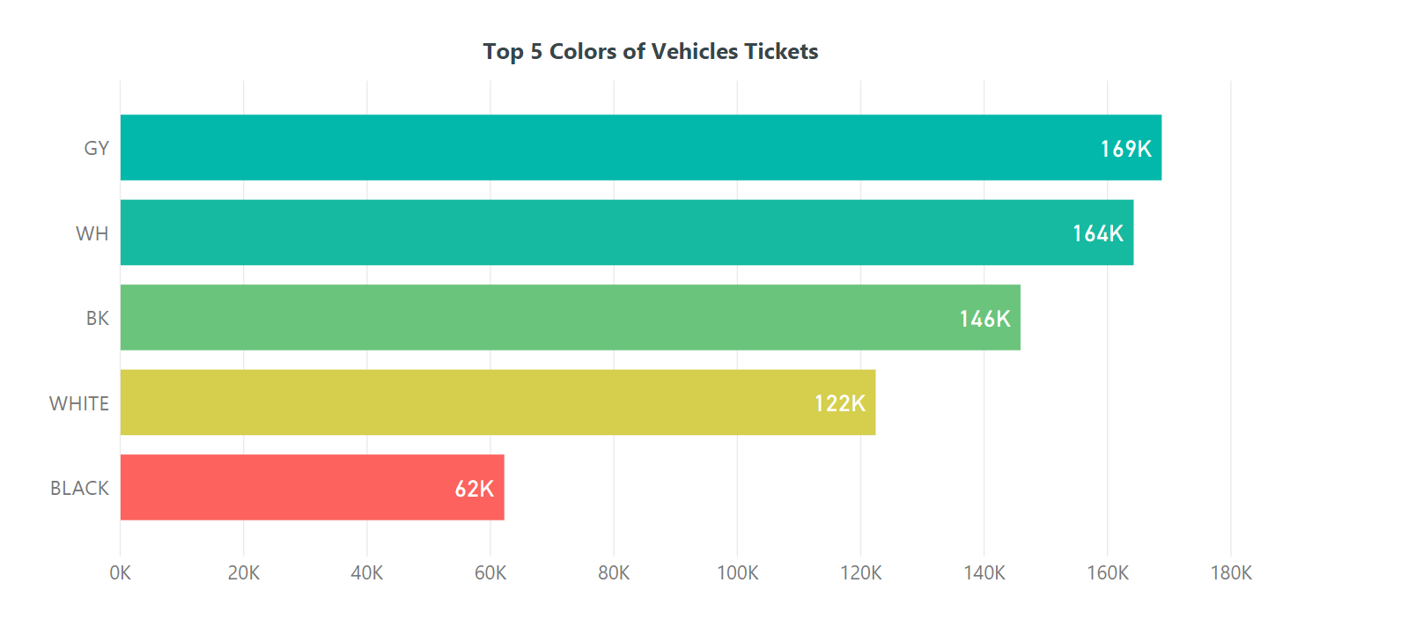
What are the top 5 colors of cars that have the most amount of parking tickets?

Slide 24
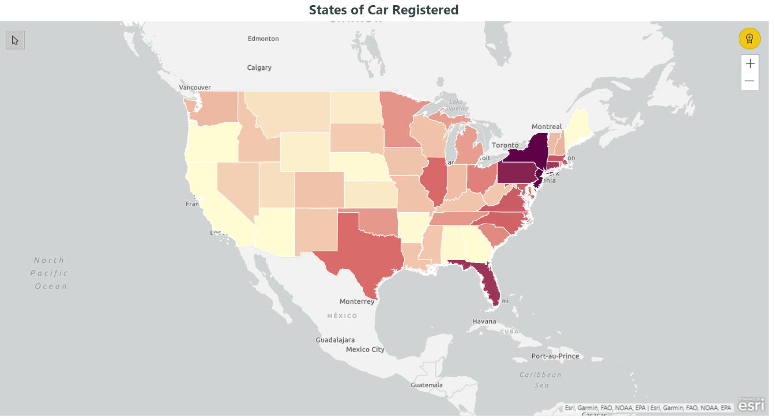
What were the states that had higher number of cars with violations in New York?
Notes:
https://www.nbcdfw.com/news/local/North-TX-Couple-Stuck-With-NYC-Parking-Ticket-Calls-NBC-5-480860961.html

Slide 25
What were the states that had higher number of cars with violations in New York?
https://www.nbcdfw.com/news/local/North-TX-Couple-Stuck-With-NYC-Parking-Ticket-Calls-NBC-5-480860961.html

Slide 26
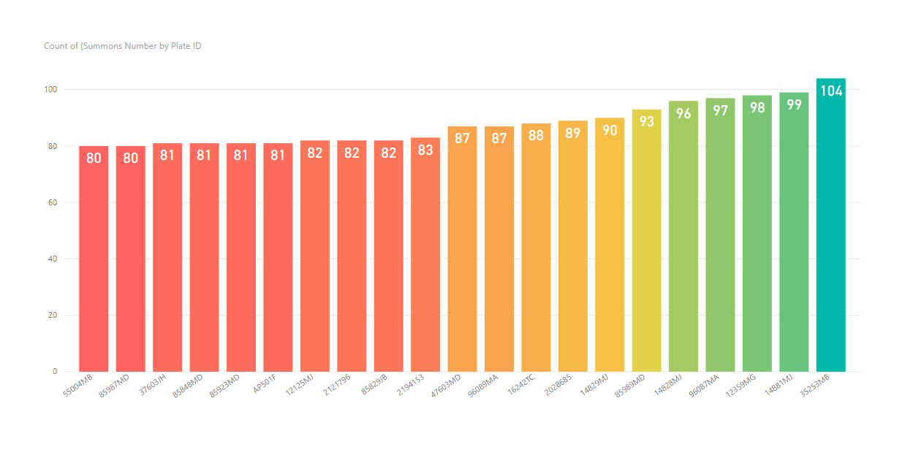
Where there any license plates that had more than 80 violations?

Slide 27

Where there any license plates that had more than 80 violations? (Continued)

Slide 28
Conclusion
We did run into some issues with the data.
However, we did find some great insights with this data.
We found that if you are ever in NYC and don’t want to get a parking violation do not drive a Grey car or a Ford.
Also that it is less likely for cars that are registered in another state to get a parking violation in NYC.

Slide 29
GitHub Link
https://github.com/oscarmnz8/Big-Data-NYC-Parking-Tickets

